Slide 1

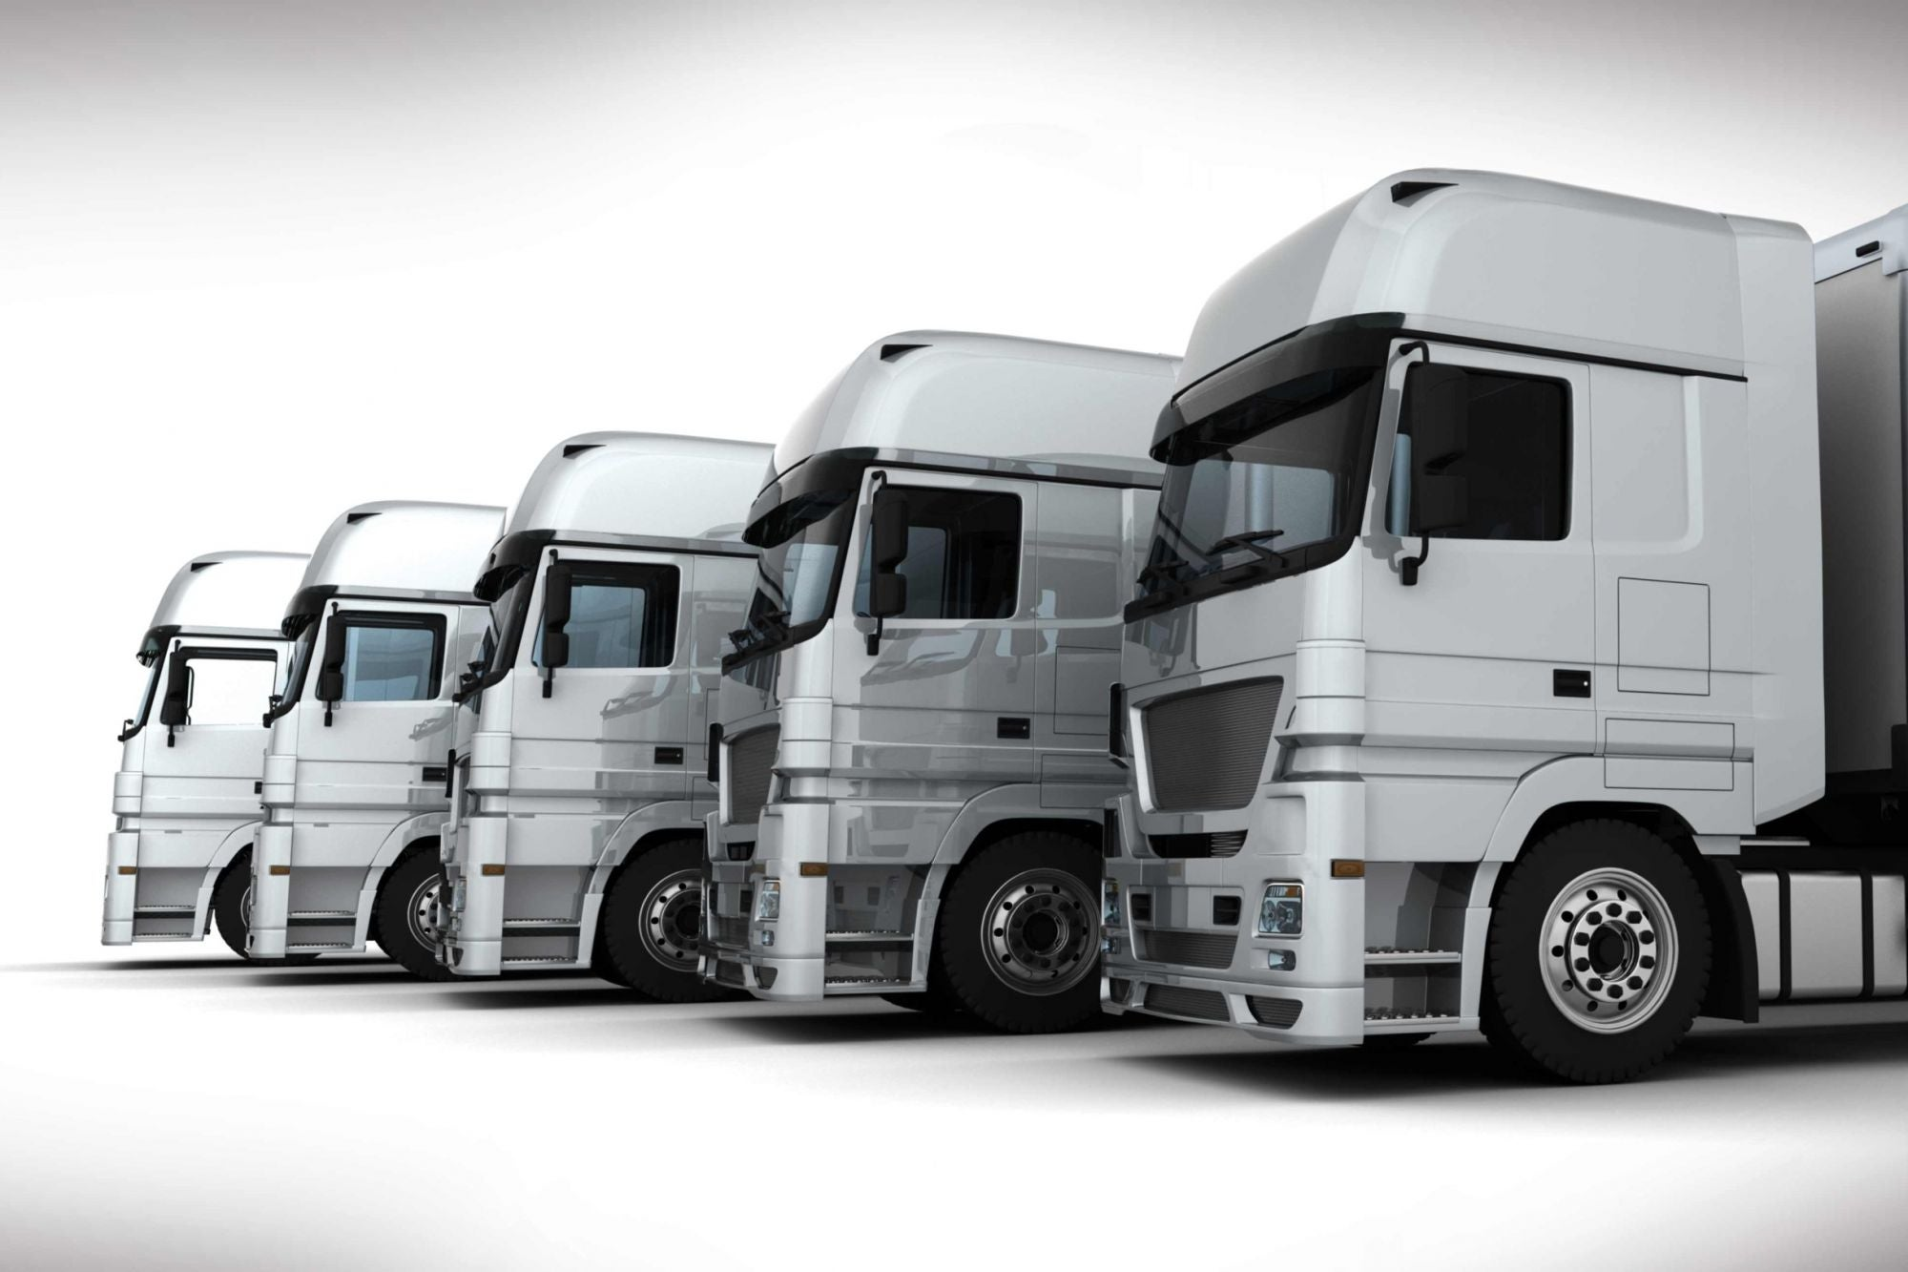
ANT Truck Data Analysis
Chia-Yao Chiu
Chitvan Bhadoria
Shilpa Nidhi Kirubanidhi
Shubhrata Gupta
Tanmayee Bhavsar
Shivani Datar
Sai Kiran Jammula
Group 7

Slide 2
Business Objective
Our goal is to identify high-risk commercial truck drivers and develop solutions to mitigate the issue, by analyzing key factors such as driver violations, risk factors, and other relevant data.
By analyzing data on geolocation, truck model, and driver behavior, we aim to identify key performance indicators such as average speeds, mileage, risk factors, and gas consumption, to inform decision-making and improve outcomes.
Through data analysis, we seek to minimize risks associated with each driver and reduce the number of accidents caused by large commercial trucks, with the ultimate goal of decreasing injuries and fatalities in California.

Slide 3
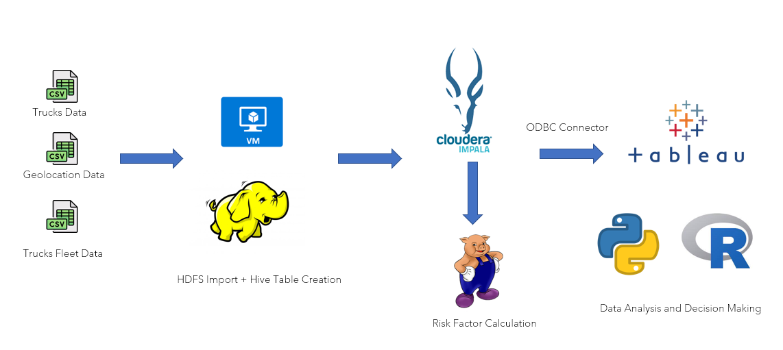
Data to Decision Model
Risk Factor Calculation

Slide 4
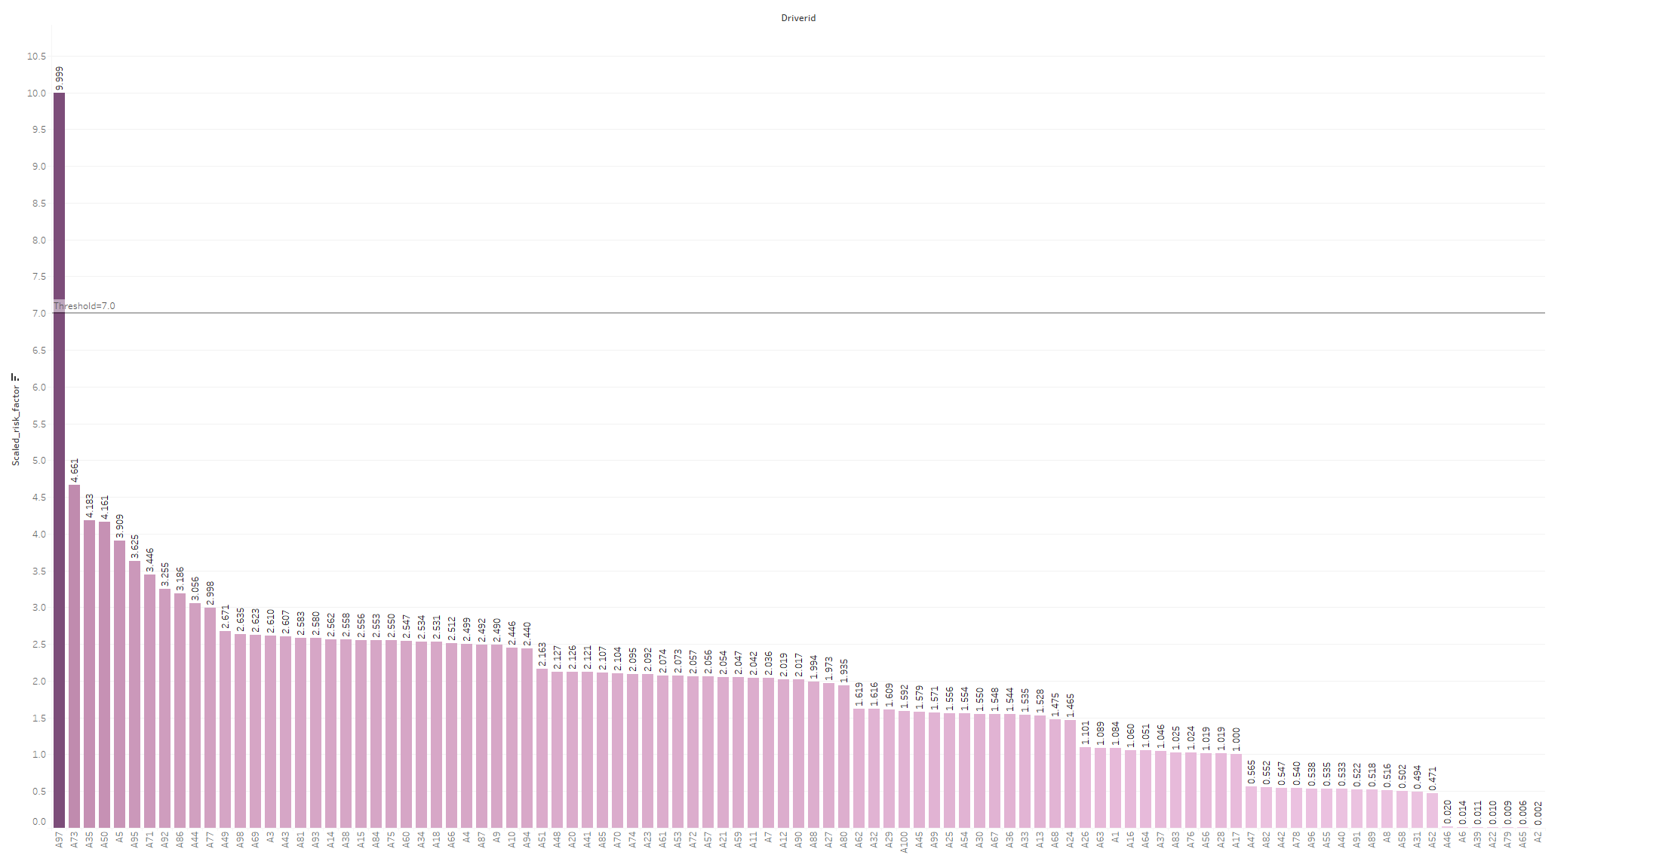
Driver Vs Scaled Risk Factor
Insights:
Driver ID A97 has the highest risk factor amongst all the drivers.

Slide 5
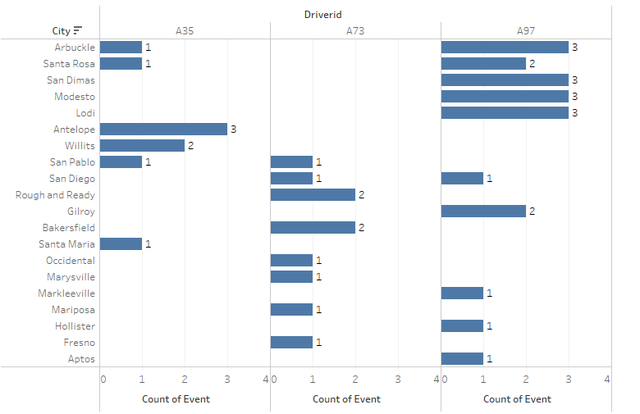
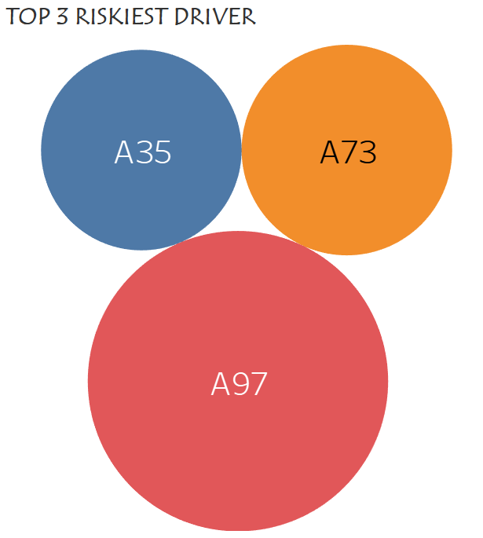
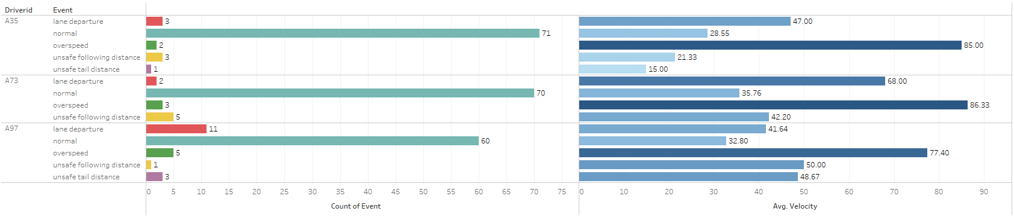
Top Risky Drivers
Recommendations:
Install lane departure warning systems and collision avoidance systems on trucks to alert drivers when they are drifting out of their lane or following too closely.
Install speed monitoring devices on trucks to track driver speed and ensure that they are adhering to speed limits.
Enforce speeding violations by ticketing drivers and imposing fines.
Use telematics technology to alert drivers when they are approaching the speed limit and remind them to slow down.
Insights:
Arbuckle, San Dimas, Modesto, and Lodi are the riskiest cities for driver ID A97 based on past incidents.
Driver A97 has had fewer normal events and more incidents related to other factors, contributing to its high-risk level.

Slide 6
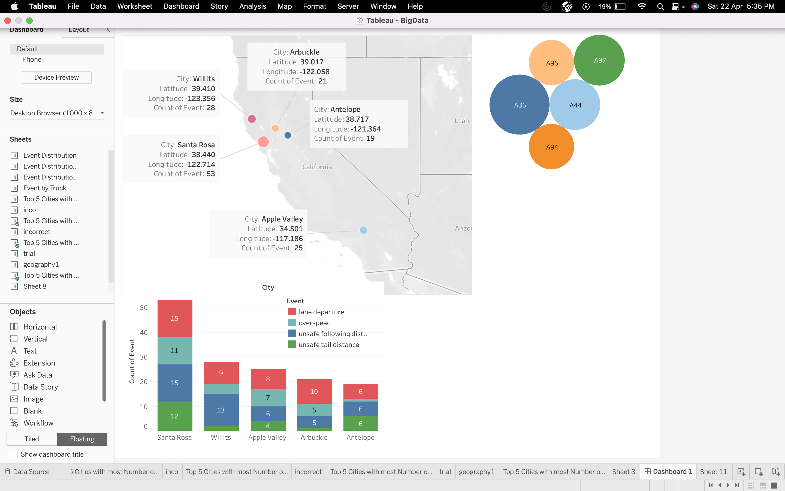
Geographical Analysis
Top 5 Risky Drivers in the Top 5 cities
Insights:
The top 4 cities with most events appear clustered with highest events occurring in Santa Rosa.
The most occurring events in these cities is lane departure and unsafe following distance.
The most prominent drivers with high risk factors are indicated.
Recommendations:
We can target the drivers with high risk factor in these cities for better training.
The training for new recruits and existing risky drivers could be more focused on avoiding lane departure and unsafe following distance issues

Slide 7
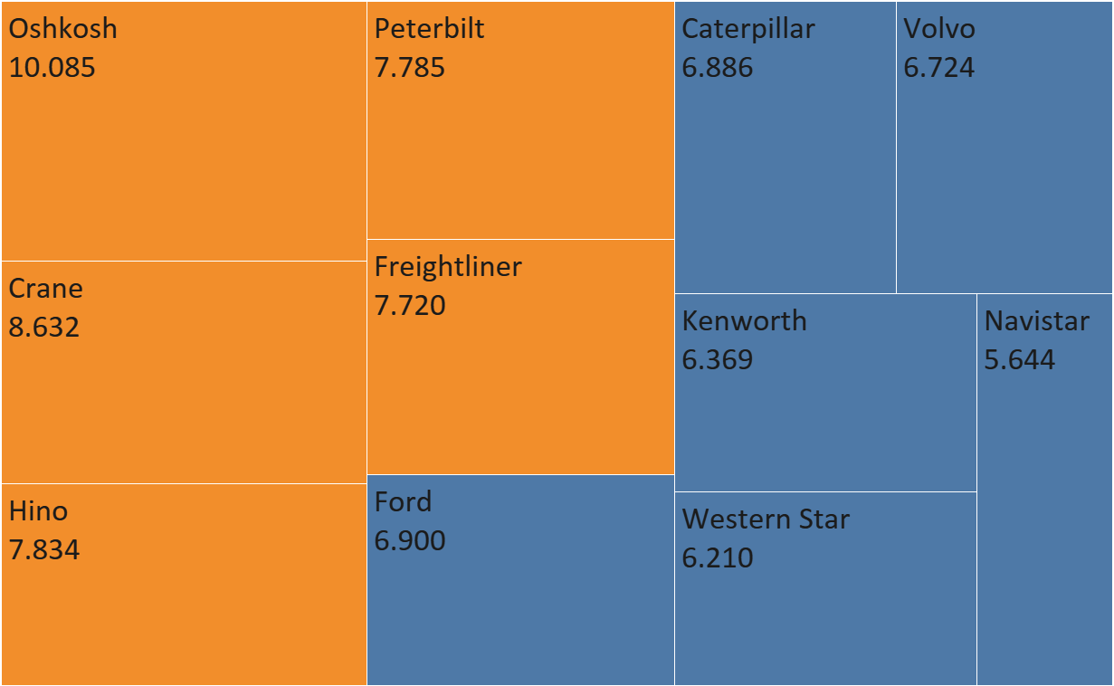
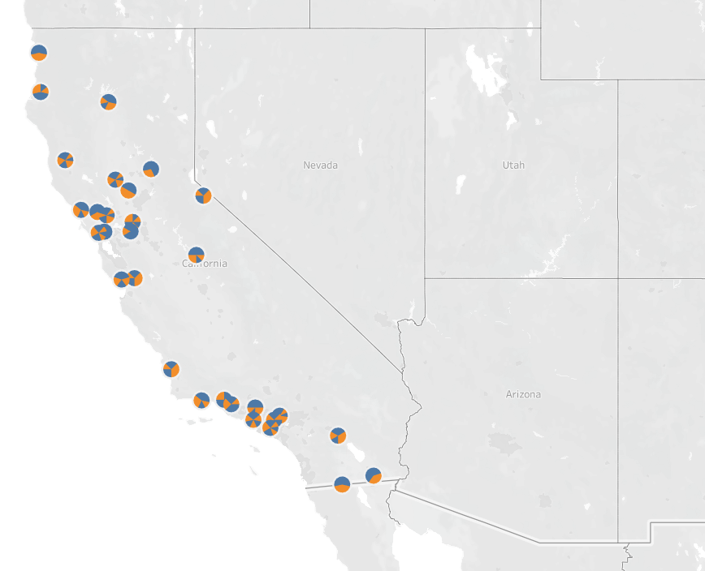
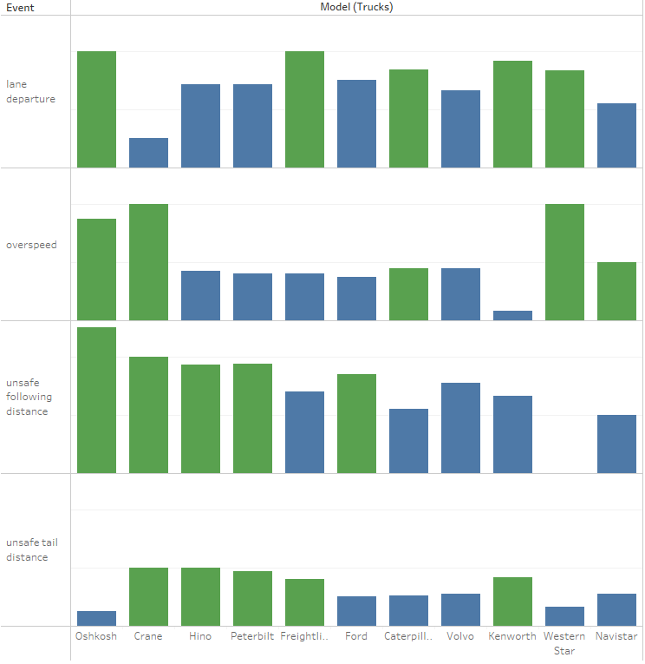
Risky Truck Models
Insights:
The Top 5 risky truck models are used equally across various cities.
The Top 5 risky truck models have a higher incidence of events related to Unsafe Following and Tail distances.
Recommendations :
Consider investing in truck models equipped with advanced technology for detecting distances between vehicles.
Emphasize driver training that focus on improving their ability to maintain safe following and tail distances.
Lane
Departure
Overspeed
Unsafe Follow
Unsafe Tail

Slide 8
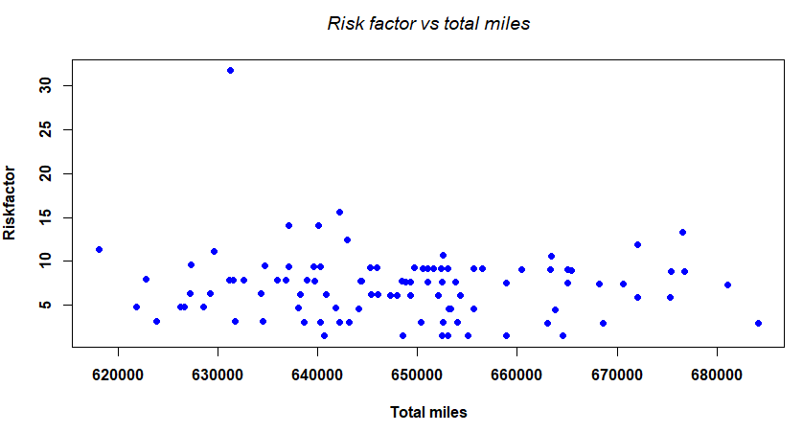
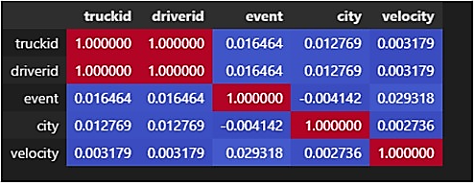
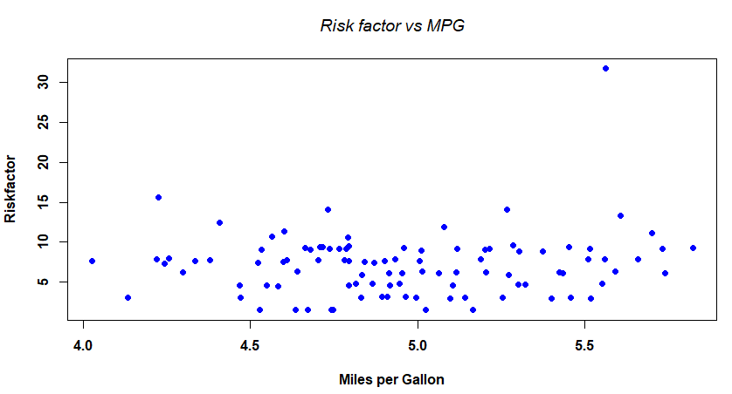
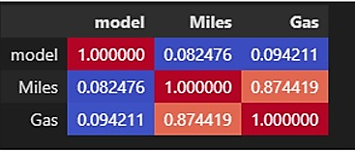
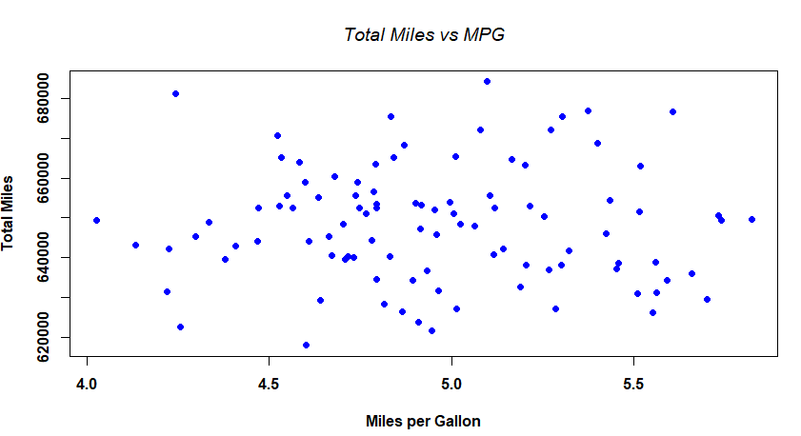
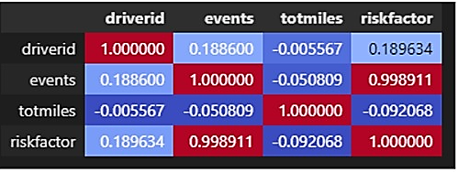
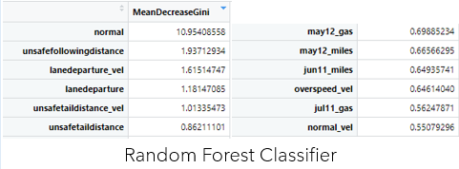
Exploratory Analysis
Geo Location Table
Interpreting correlation between data
-1 implies strongly negative correlation
0 implies no correlation
+1 implies strongly positive correlation
Results shows there is no much correlation between any 2 fields
This shows that we need:
More Historical data
More precise data
Trucks_mg table
Risk Factor Table

Slide 9
Conclusion
Driver A97 is the riskiest of all and we recommend using advanced speed monitoring equipment and lane departure alerting systems.
Raising awareness about safe driving practices and violations could help mitigate risk for drivers who frequently drive on routes in northwest California.
To reduce risk for drivers, the company should consider providing training specifically for those with the highest risk factors and increasing awareness about safe driving practices and violations for those who regularly drive in northwest California.
Invest in trucks equipped with advanced distance-detecting technology to enhance their proficiency in maintaining safe following and tail distances.

